Slide 1

Developed by
Ankit Khandelwal
GUIDED BY
Dr. H. S. Mazumdar

Slide 2
Fuse Bits
FUSE ?
  The purpose of a fuse is to open an electronic circuit when current flow exceeds a certain amount, determined by the rating of the fuse. Opening a circuit under high current conditions can save electronic components from damaged and prevents overheating, which could cause a fire.
  Similarly in microcontroller the analogy of fuse is to drive microcontroller. It decides the driving speed i.e. the speed at which microcontroller would function the instruction given to it. Apart from driving speed the important controls provided by fuse bits is described in further slides.
You will need to know how to program these fuse bytes in order to get the most out of your microcontroller (or get it working at all!) and this simple tutorial will get you started right.

Slide 3
Fuse bits?
  Members of the AVR family can have one or more fuse bytes. How many, and what they tell the chip to do, depends on the specific microcontroller (e.g. a ATMega16 has both high and low fuse bytes, for a total of 16 configuration bits, while an ATtiny12 has only eight fuse bits).
  We will consider both high byte and low byte for programming. So we have to consider 16 bits of programming the 16 bits to be considered are shown in table in next slide

Slide 4
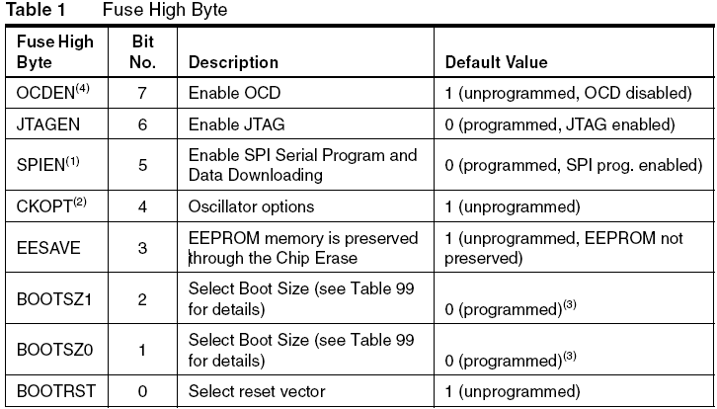
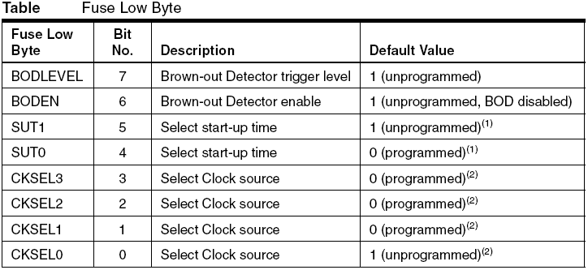

Slide 5
Bits of Interest
  The ATmega16 ships with safe default settings for its clock source and startup time, which specify that an internal 1 MHz RC oscillator is to be used. This ensures that you can get the chip working with minimal setup but lets assume you want to take advantage of a faster/more stable/more useful clock through the use of an external crystal.
  By checking the Clock Sources section of the datasheet, you can see that the clocking options are set using 4 CKSEL bits that specify the type of clock source the chip will use, and the CKOPT bit (which tells the chip to pay attention to our CKSEL bits and influences startup time).
  The actual bits you use depend on the hardware you've got. Here we'll say we're using a 2MHz crystal. In this case, we determine that we should set CKSEL3..0 (this notation, used in the datasheets, indicates CKSEL bits 3 to 0, starting at 3) to 1100 and we should also ensure the CKOPT bit is 1.

Slide 6
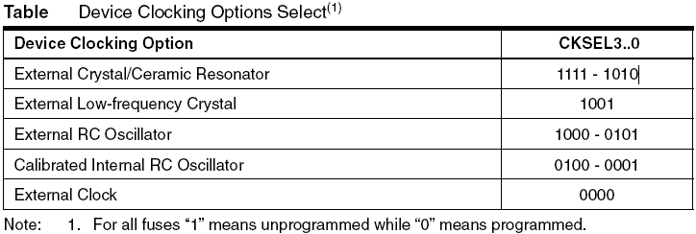

Slide 7
How to read fuse bits?
The datasheet for each microcontroller contains (excruciatingly?) detailed information on the fuse bits available and their function, but often leaves a bit to be desired in terms of an overview of the actual process of setting these fuses. Matters are made worse by the fact that, for AVR micros, having a “1" in a bit means it is unprogrammed while having a “0" is considered to be programmed and that the documentation will often use language such as "... clear bit 7 to enable blah blah" which can leave you wondering whether this means you should set it to 0 or not
How to use fuses wisely so that damages can be prevented?

Slide 8
Final things To Remember
The fuses aren't erased when the AVR memory is erased, so reprogramming the fuses every time the device is reprogrammed is not required. Since the fuses are not cleared by a memory erase, it can cause problems if incorrect settings are selected.
It may be possible to disabled In-System Programming (through the SPIEN fuse) while performing in-system programming. If you do this, you will no longer be able to program the chip in this manner (you need to use parallel programming to change this setting, which may mean removing the chip from the circuit and using another hardware programmer, such as the STK500).
It may also be possible to disable the RESET pin (RSTDISBL fuse). If this happens, the RESET pin must be pulled very high (12V) to program the chip and the circuit must tolerate this.
Some fuses just can't be changed through ISP Programming. If fuses cannot be changed through ISP Programming, Parallel Programming is required to alter the fuses.
The lock bits are fuses that can be used to lock down the chip, but this can lock you out as well!

Slide 9
Lock Bits
FUSE ?
  The purpose of a fuse is to open an electronic circuit when current flow exceeds a certain amount, determined by the rating of the fuse. Opening a circuit under high current conditions can save electronic components from damaged and prevents overheating, which could cause a fire.
  Similarly in microcontroller the analogy of fuse is to drive microcontroller. It decides the driving speed i.e. the speed at which microcontroller would function the instruction given to it. Apart from driving speed the important controls provided by fuse bits is described in further slides.
You will need to know how to program these fuse bytes in order to get the most out of your microcontroller (or get it working at all!) and this simple tutorial will get you started right.

